Slide 1
0
去意大利旅游的时候拍了很多照片，
选了一些来制作模板，
送你，喜欢就好。

Slide 2
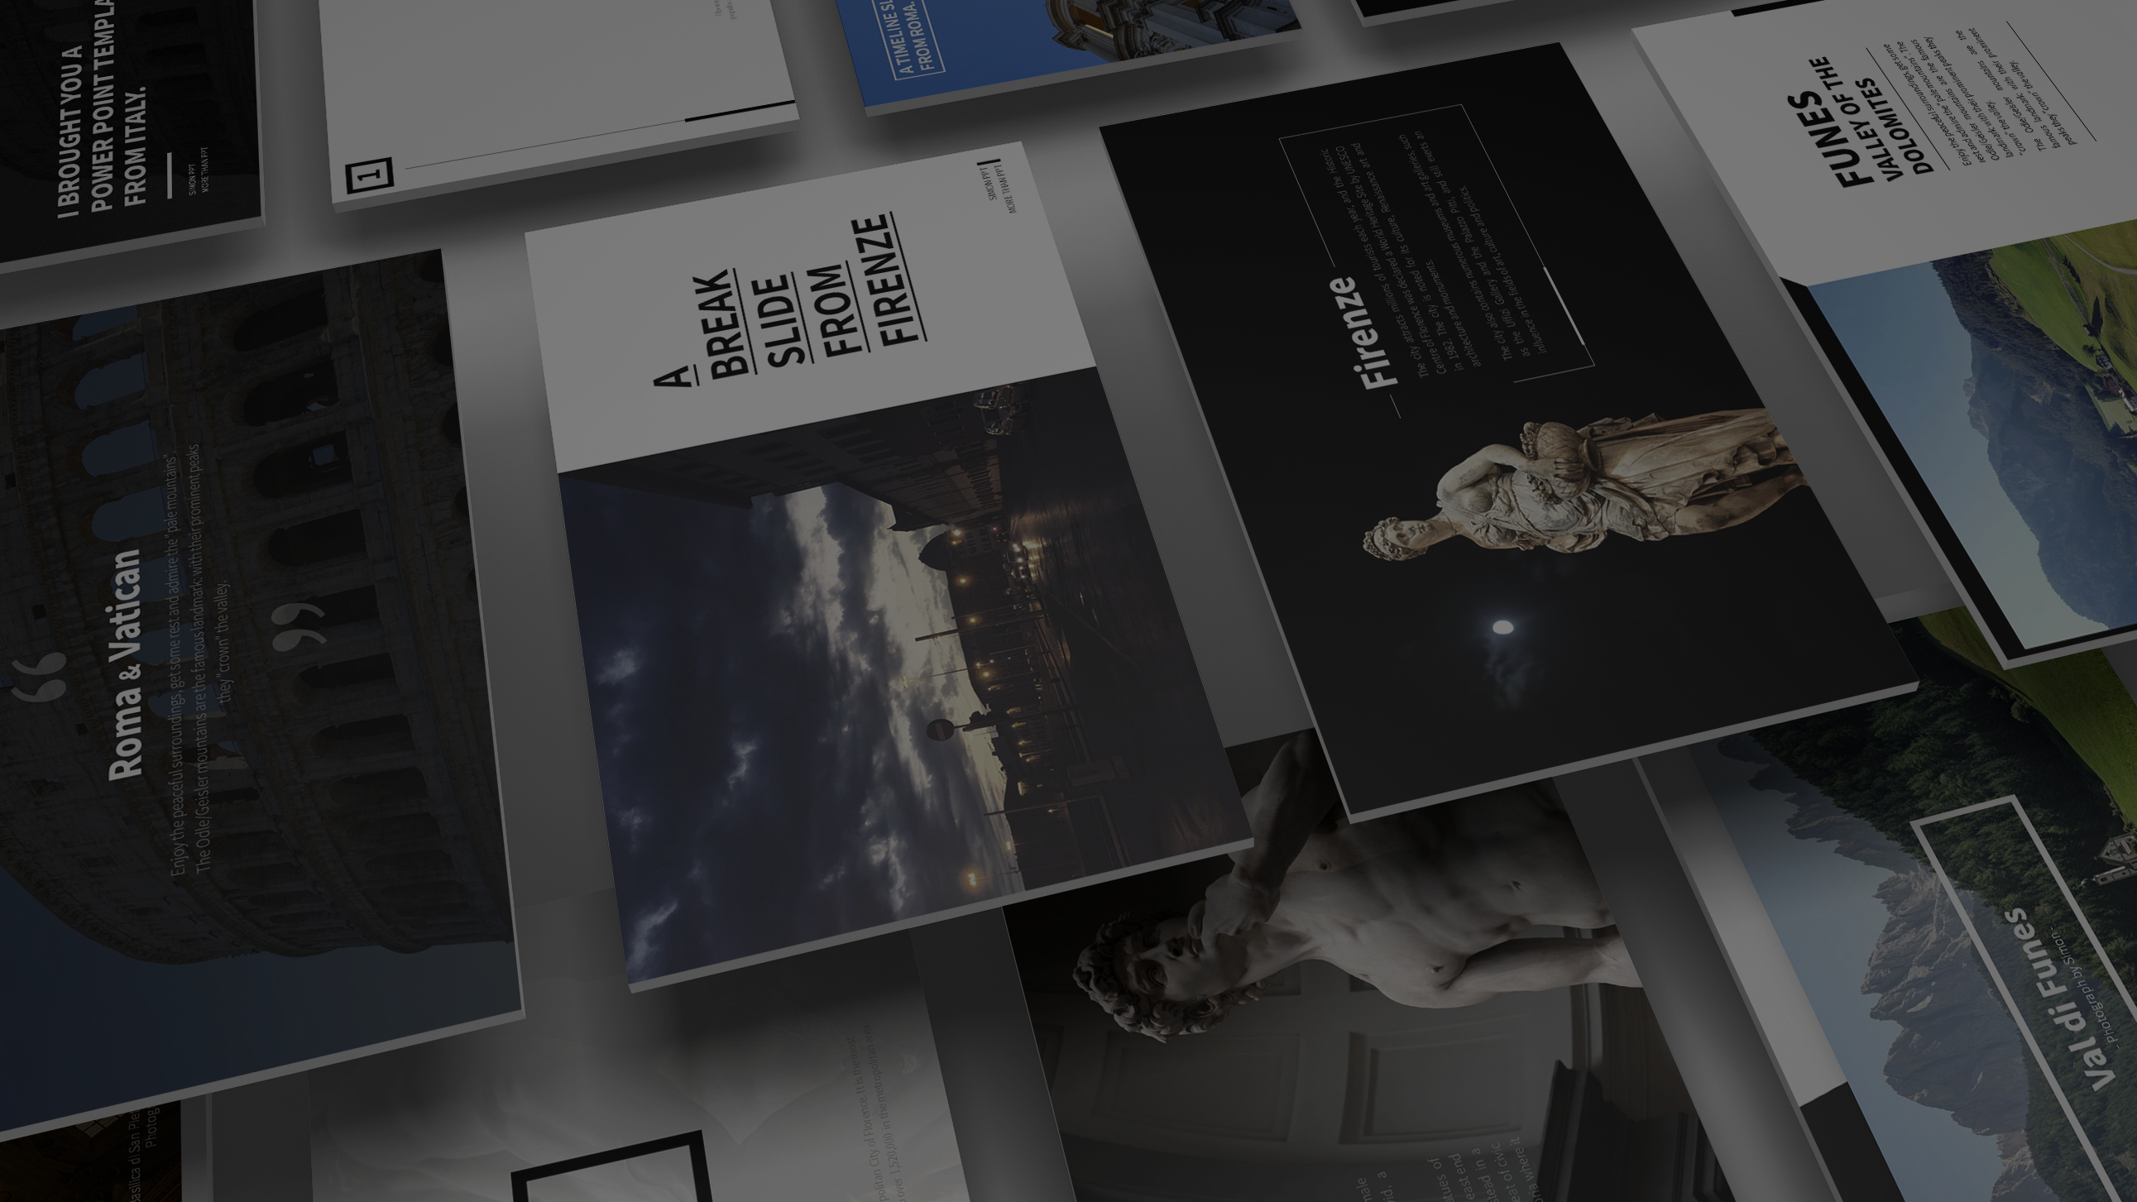

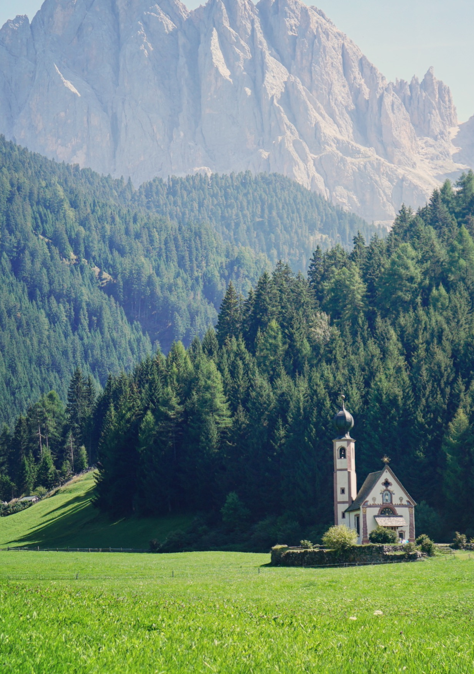
SIMON PPT
Say hello to Italy.

Slide 3
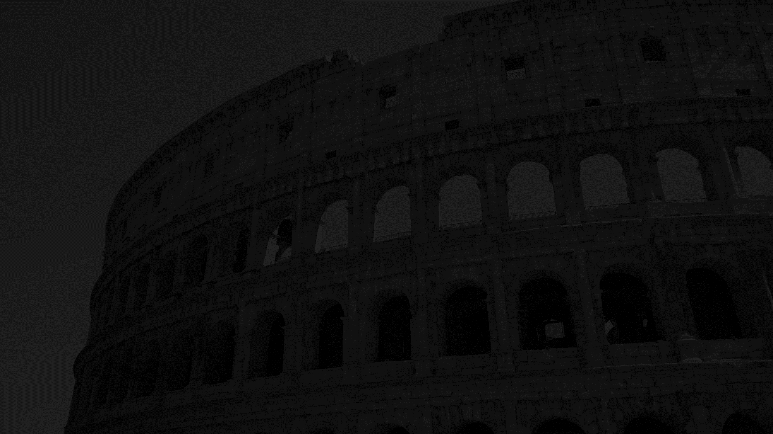
I BROUGHT YOU A
POWER POINT TEMPLATE
FROM ITALY.
SIMON PPT
MORE THAN PPT

Slide 4
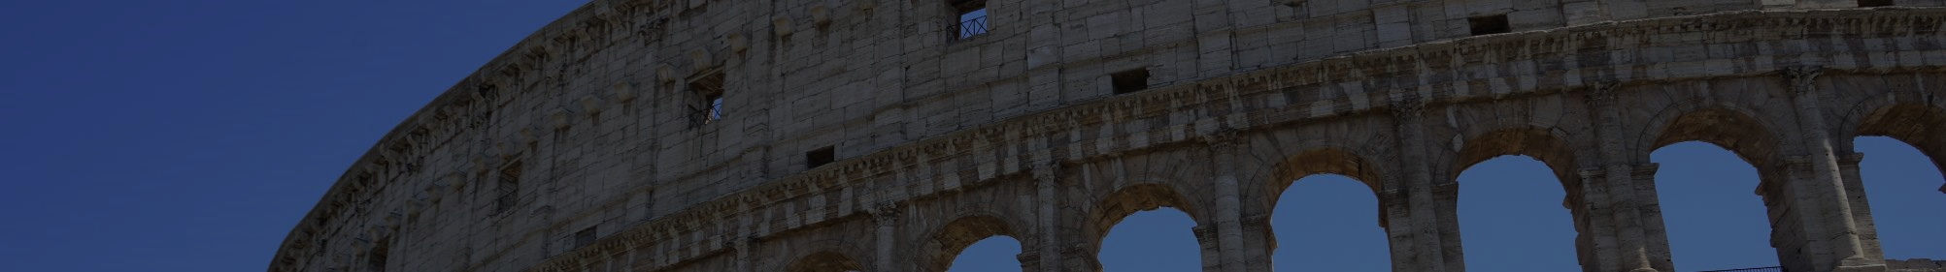
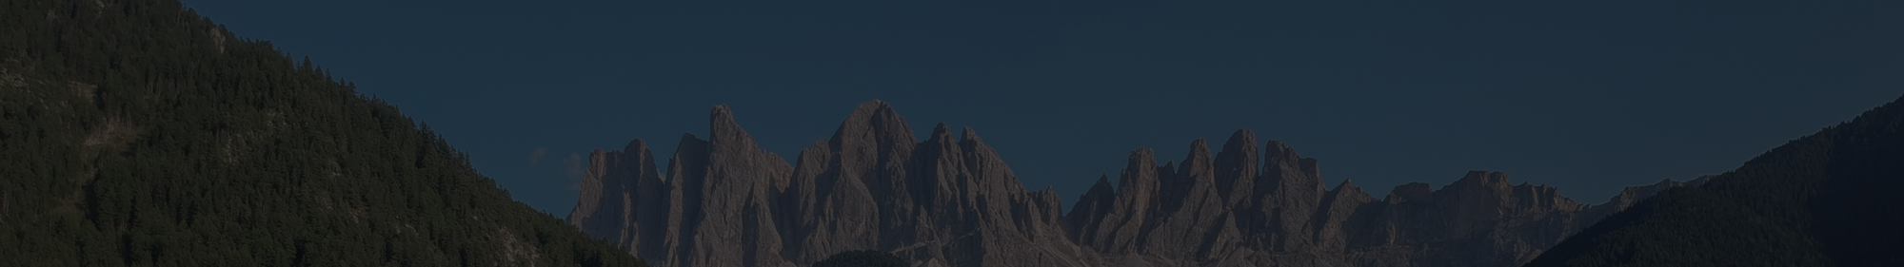
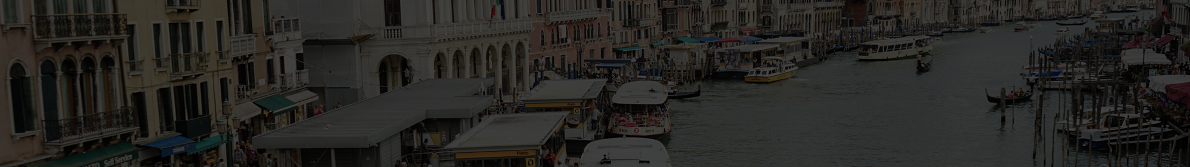

1
PART
ONE
2
PART
TWO
3
PART
THREE
4
PART
FOUR

Slide 5
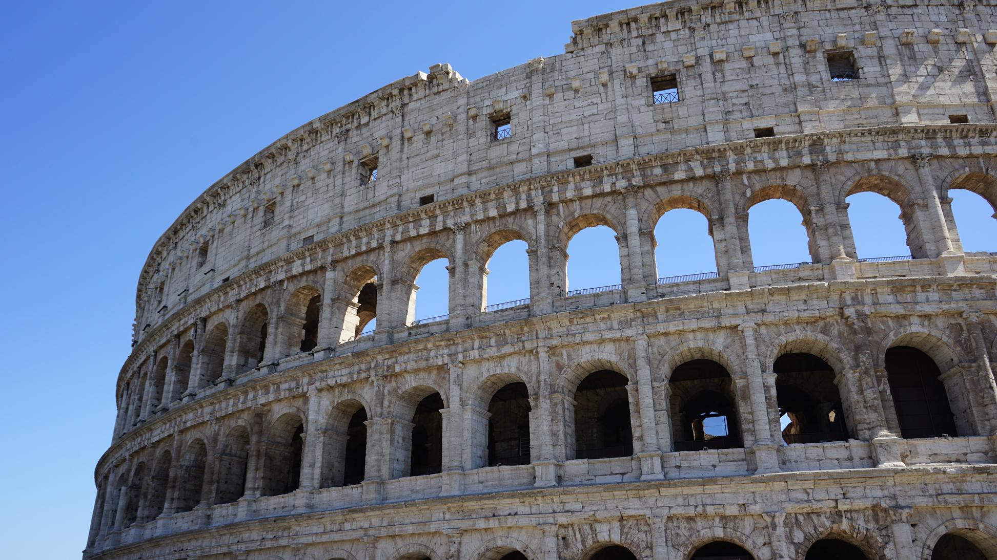
1
1
PART
ONE
Florence is the capital city of the Italian region of Tuscany and of the Metropolitan City of Florence. It is the most populous city in Tuscany, with 383,083 inhabitants (as at 2013), expanding to over 1,520,000 in the metropolitan area.

Slide 6

Roma & Vatican
Enjoy the peaceful surroundings, get some rest and admire the "pale mountains".
The Odle/Geisler mountains are the famous landmark: with their prominent peaks they "crown" the valley.

Slide 7
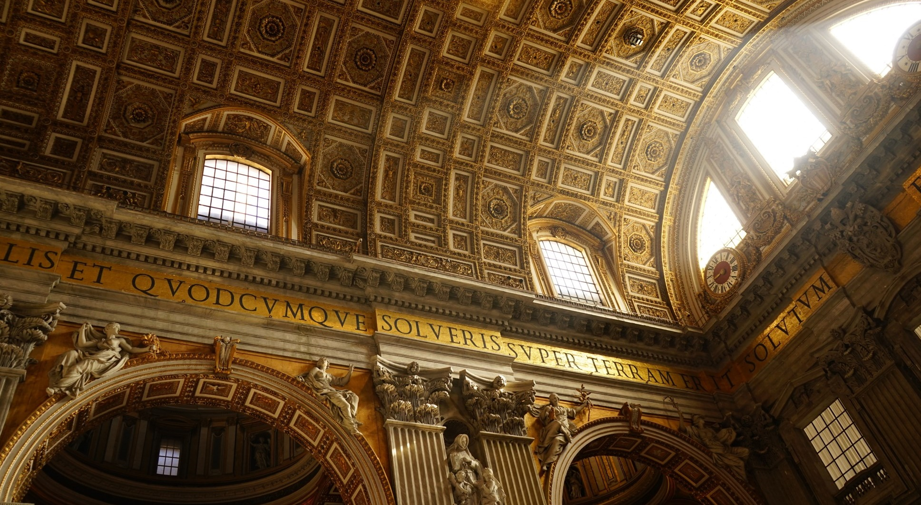
LET
THERE
BE LIGHT.
Basilica di San Pietro in Vaticano
Photograph by Simon

Slide 8
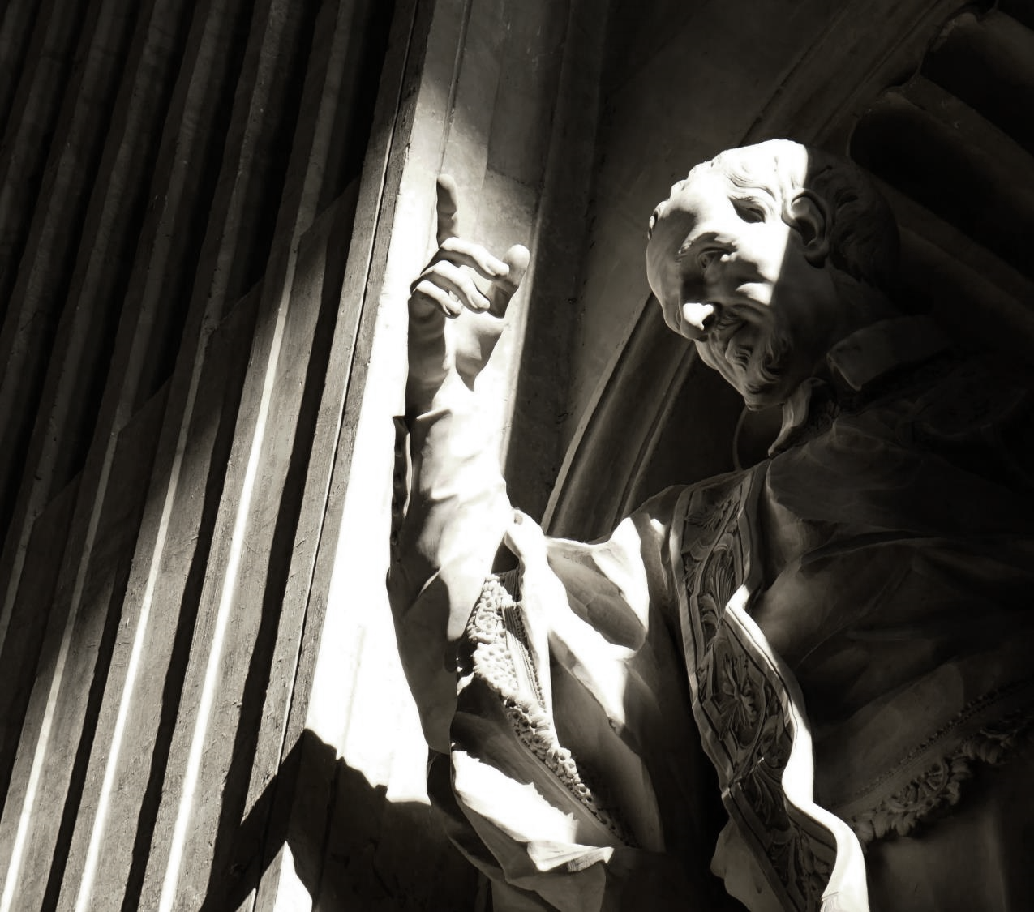
LET
THERE
BE LIGHT
AND THERE WAS
LIGHT.

Slide 9
A TIMELINE SLIDE
FROM ROMA.
2018
It is the fourth-most populous city in the European Union by population within city limits.
2019
It is the fourth-most populous city in the European Union by population within city limits.
2020
It is the center of the Metropolitan City of Rome, which has a population of 4.3 million residents.

Slide 10
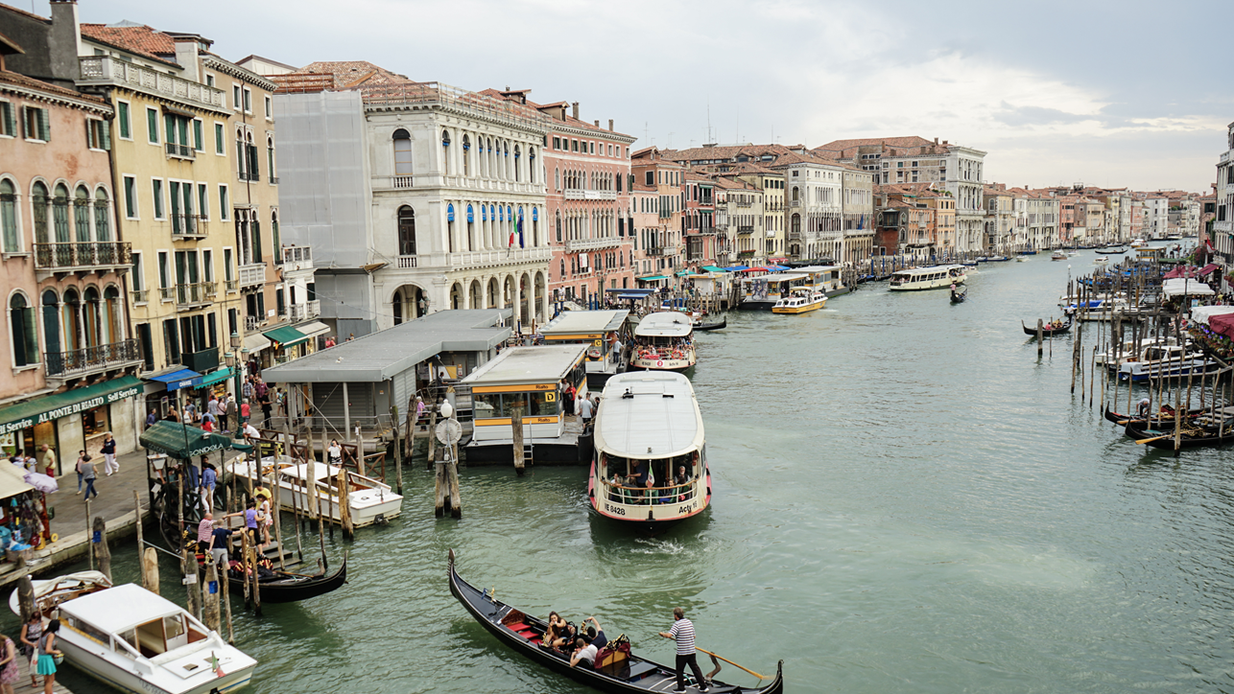
2
2
PART
TWO
Florence is the capital city of the Italian region of Tuscany and of the Metropolitan City of Florence. It is the most populous city in Tuscany, with 383,083 inhabitants (as at 2013), expanding to over 1,520,000 in the metropolitan area.

Slide 11

Venezia
Venezia is a city in northeastern Italy and the capital of the Veneto region. It is situated across a group of 118 small islands[1] that are separated by canals and linked by bridges, of which there are 400.

Slide 12
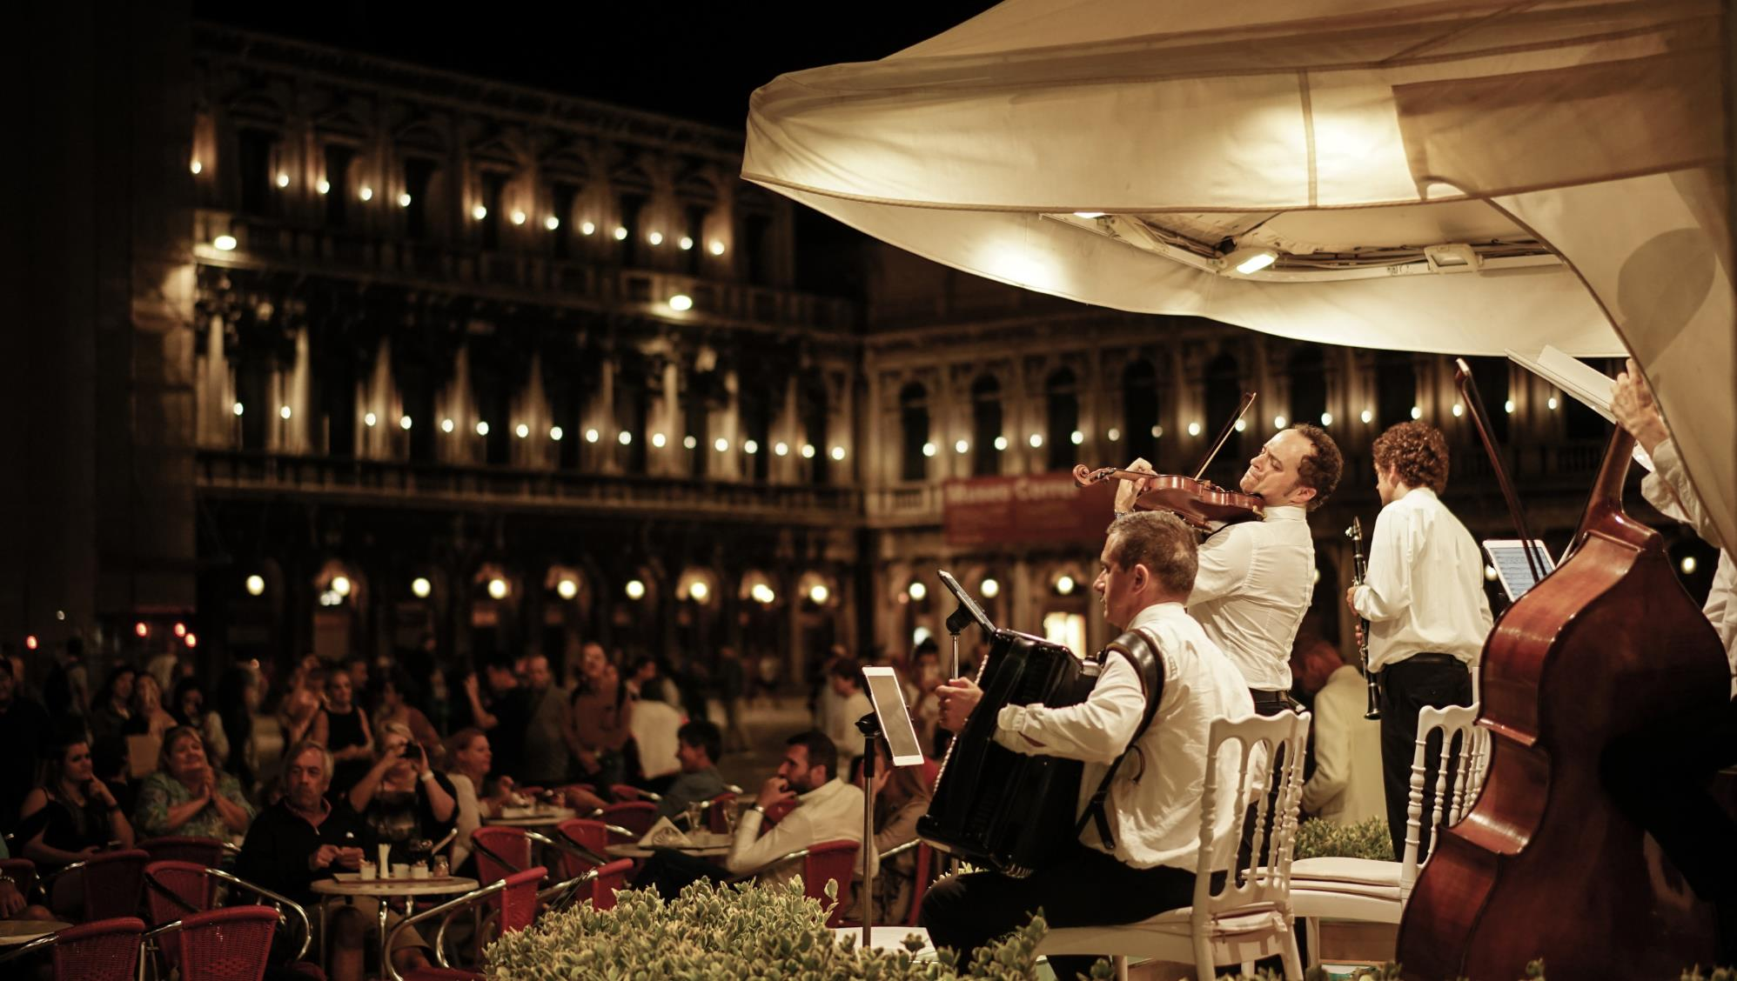
ENJOY
RESPECT
VENEZIA
Venezia is a city in northeastern Italy and the capital of the Veneto region. It is situated across a group of 118 small islands[1] that are separated by canals and linked by bridges, of which there are 400.

Slide 13
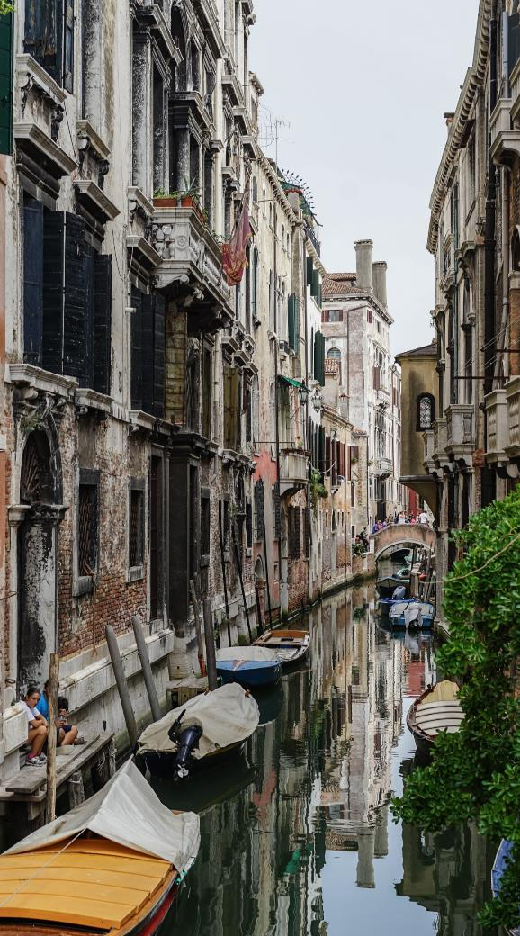
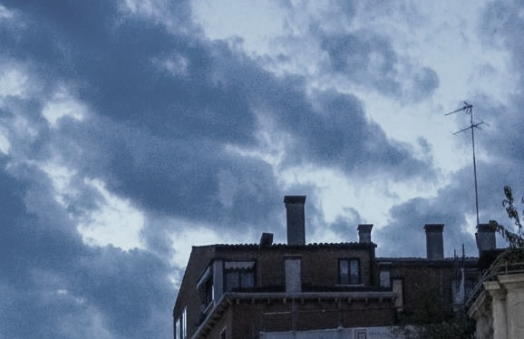
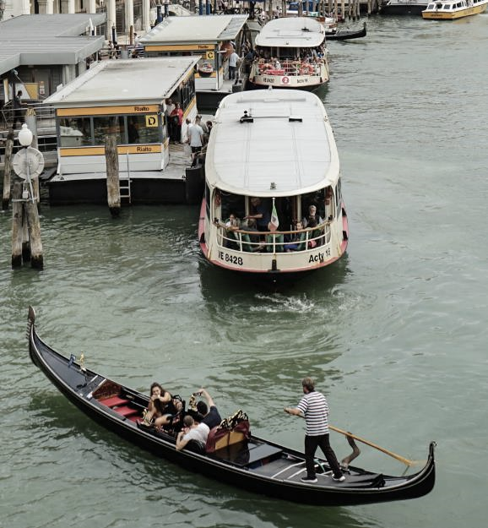
ENJOY
RESPECT
VENEZIA
Venezia is a city in northeastern Italy and the capital of the Veneto region. It is situated across a group of 118 small islands[1] that are separated by canals and linked by bridges, of which there are 400.

Slide 14
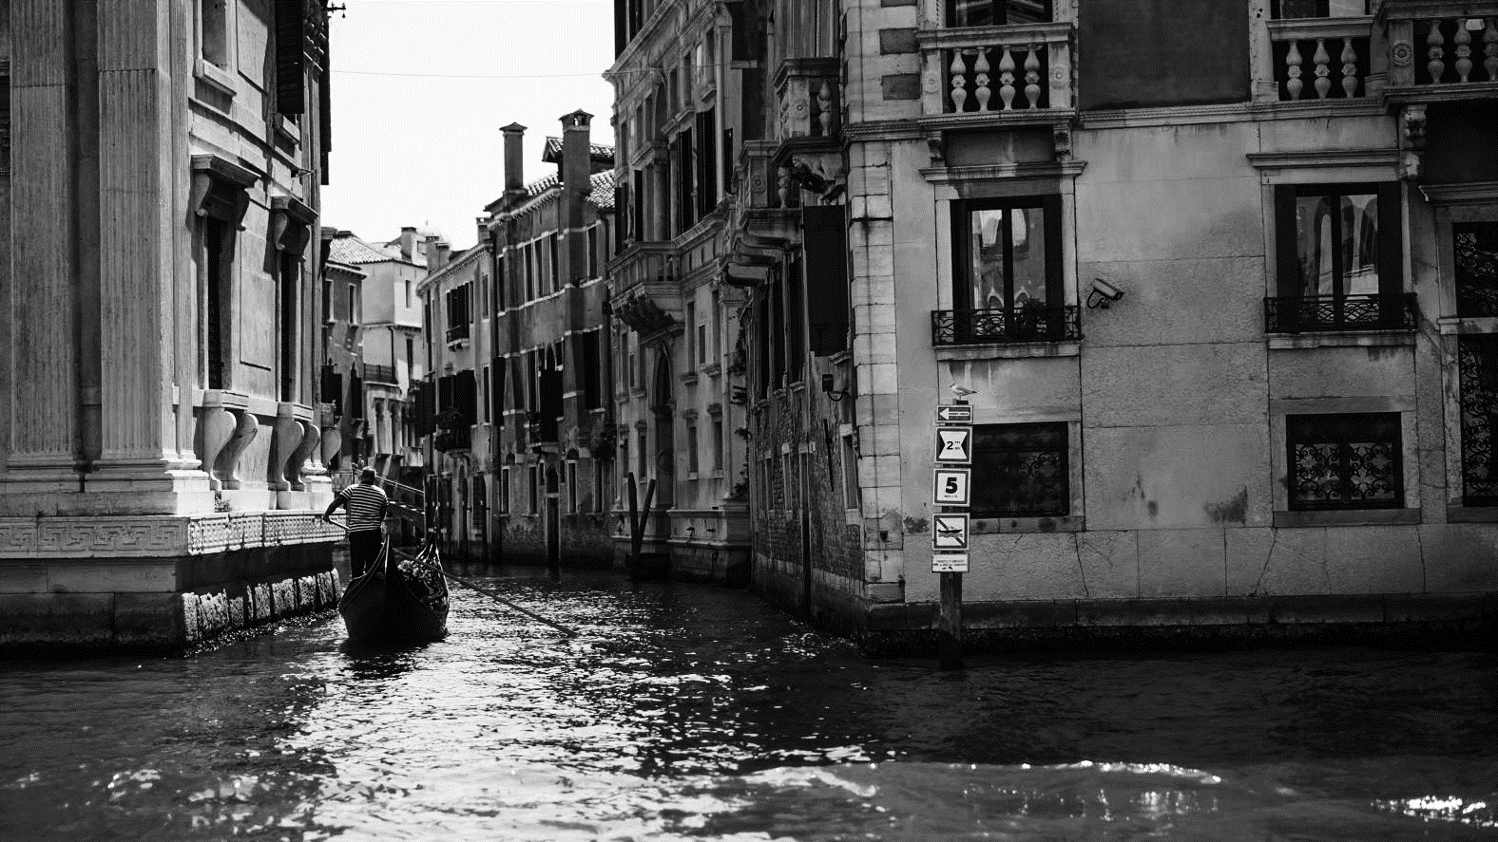
ENJOY
2017
RESPECT
VENEZIA
Venezia is a city in northeastern Italy and the capital of the Veneto region. It is situated across a group of 118 small islands[1] that are separated by canals and linked by bridges, of which there are 400.

Slide 15
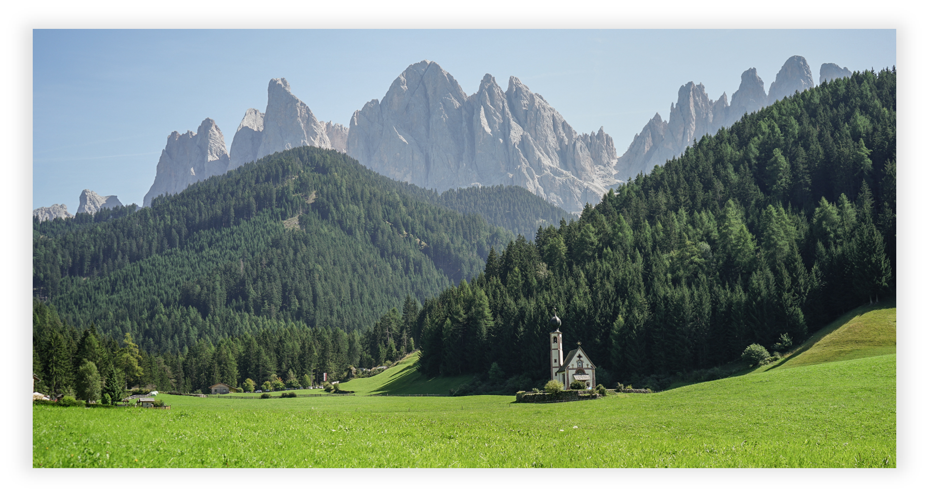
3
3
PART
THREE
Florence is the capital city of the Italian region of Tuscany and of the Metropolitan City of Florence. It is the most populous city in Tuscany, with 383,083 inhabitants (as at 2013), expanding to over 1,520,000 in the metropolitan area.

Slide 16
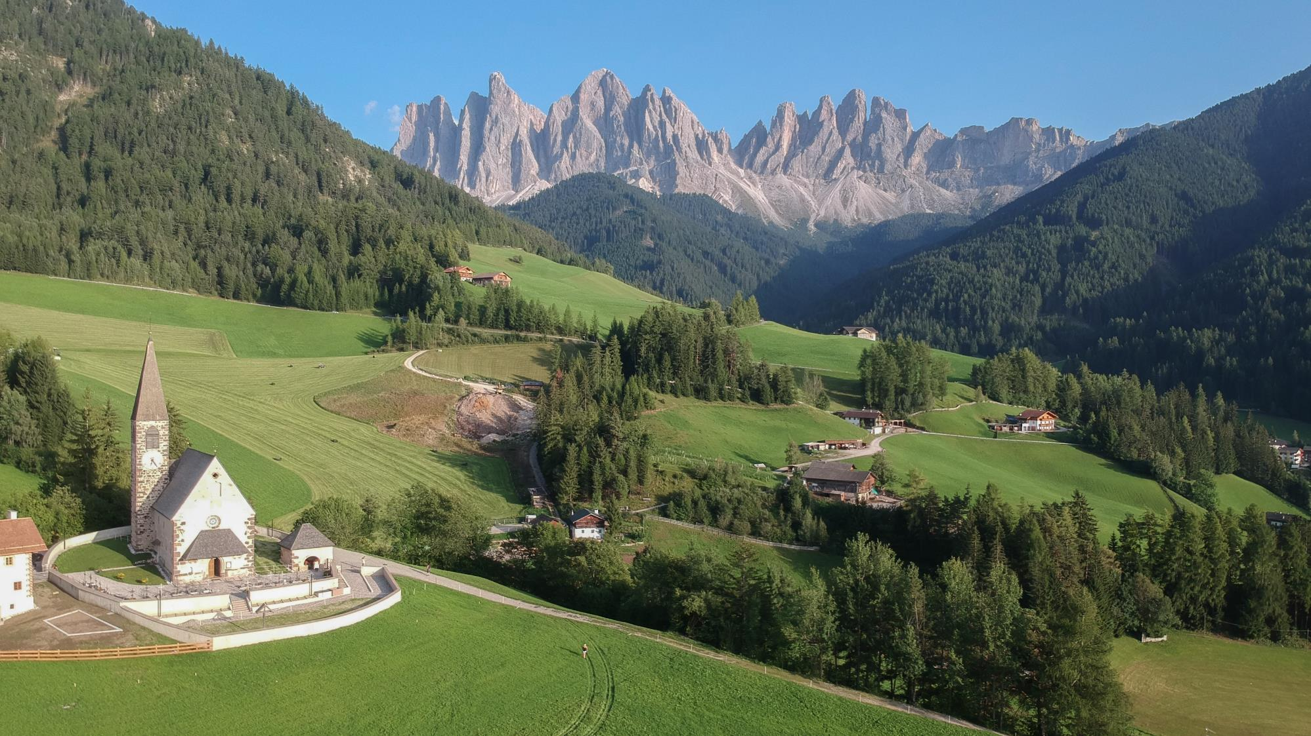
Val di Funes
Enjoy the peaceful surroundings, get some rest and admire the "pale mountains".
The Odle/Geisler mountains are the famous landmark: with their prominent peaks they "crown" the valley.

Slide 17
STEP 1
STEP 3
STEP 5
The Odle/Geisler mountains are the famous landmark: with their prominent peaks they "crown" the valley.
The Odle/Geisler mountains are the famous landmark: with their prominent peaks they "crown" the valley.
Enjoy the peaceful surroundings, get some rest
2018
2020
2017
2019
2021
STEP 2
STEP 4
The Odle/Geisler mountains are the famous landmark: with their prominent peaks they "crown" the valley.
The Odle/Geisler mountains are the famous landmark: with their prominent peaks they "crown" the valley.

Slide 18
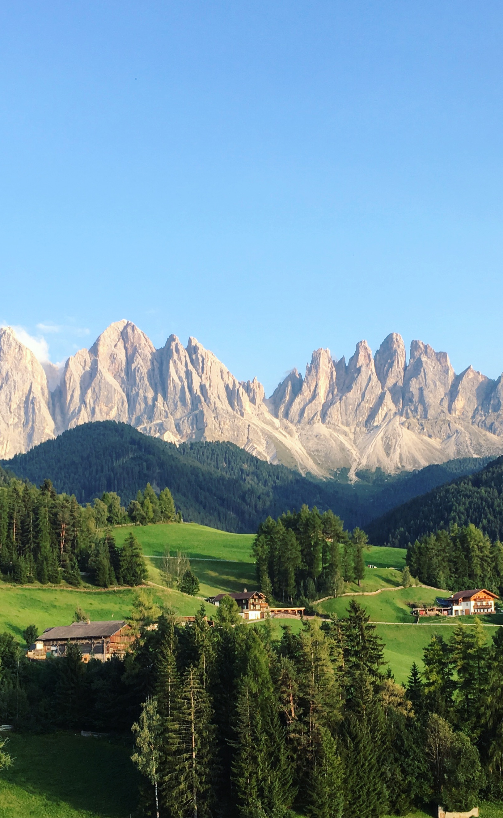
FUNES
VALLEY OF THE
DOLOMITES
Enjoy the peaceful surroundings, get some rest and admire the "pale mountains". The Odle/Geisler mountains are the famous landmark: with their prominent peaks they "crown" the valley.
The Odle/Geisler mountains are the famous landmark: with their prominent peaks they "crown" the valley.

Slide 19
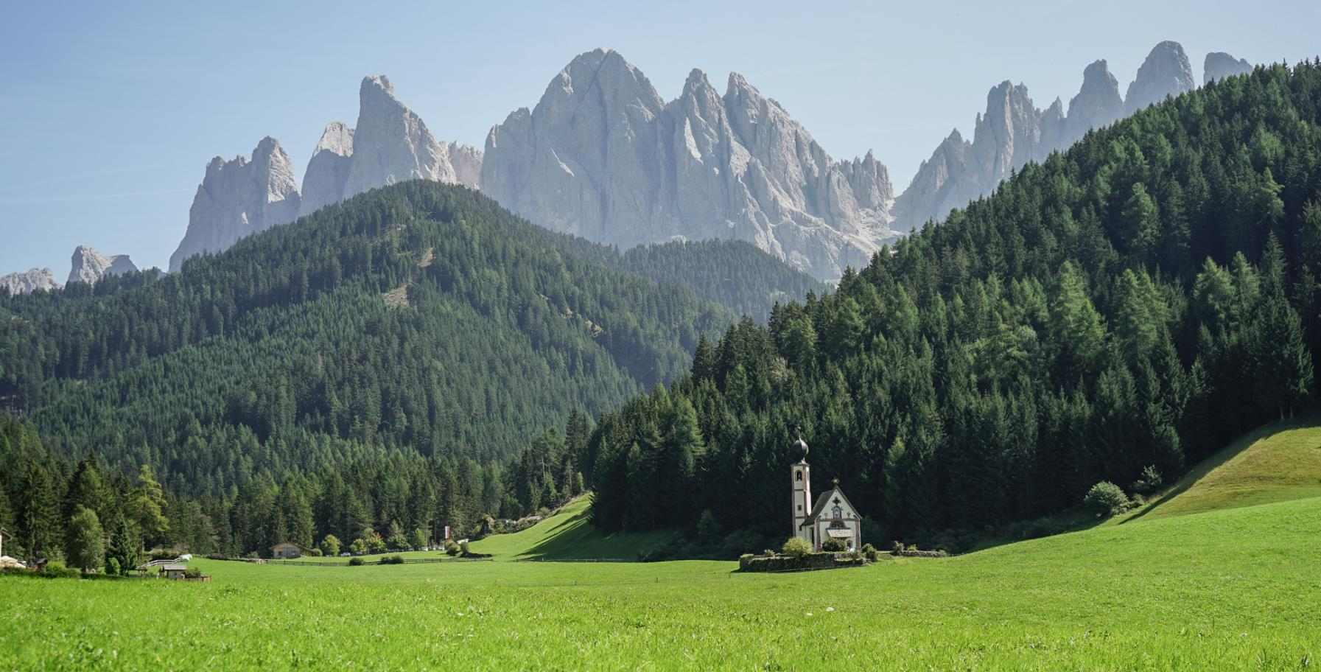
Val di Funes
- Photograph by Simon -

Slide 20
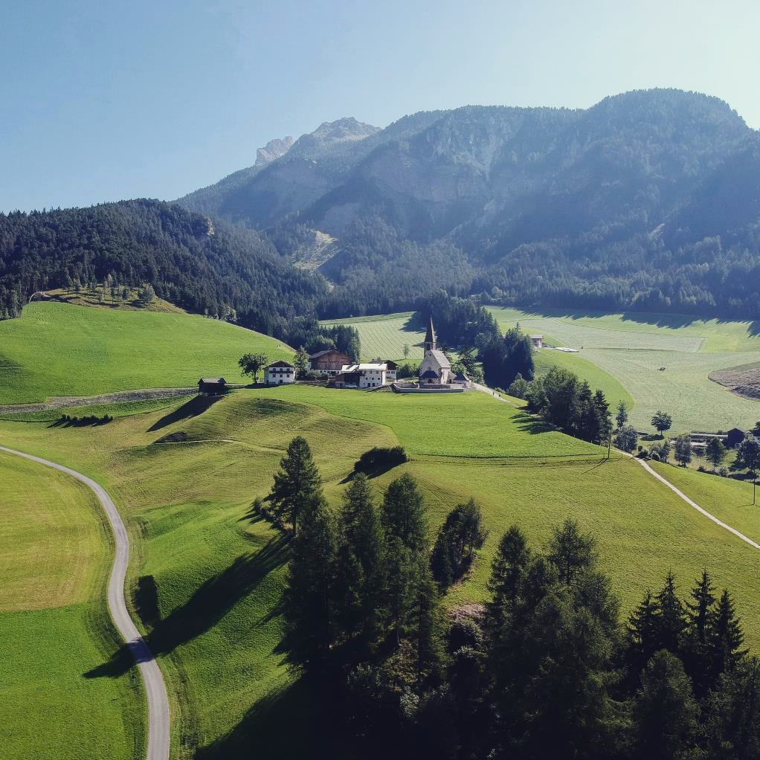
FUNES
VALLEY OF THE
DOLOMITES
Enjoy the peaceful surroundings, get some rest and admire the "pale mountains". The Odle/Geisler mountains are the famous landmark: with their prominent peaks they "crown" the valley.
The Odle/Geisler mountains are the famous landmark: with their prominent peaks they "crown" the valley.

Slide 21
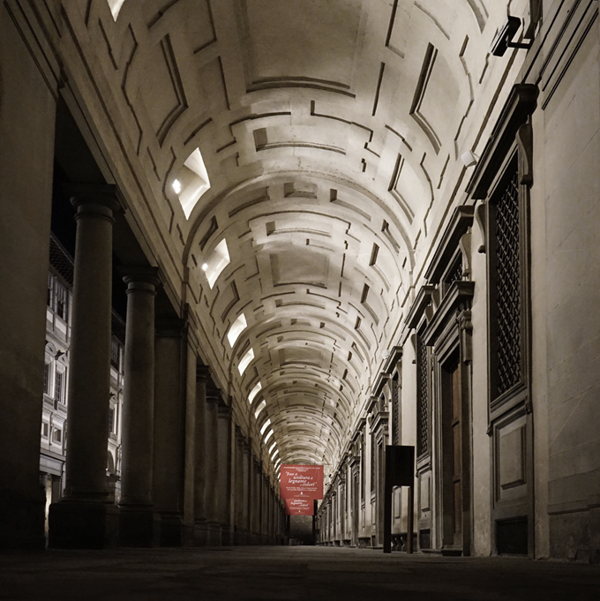
4
4
PART
FOUR
Florence is the capital city of the Italian region of Tuscany and of the Metropolitan City of Florence. It is the most populous city in Tuscany, with 383,083 inhabitants (as at 2013), expanding to over 1,520,000 in the metropolitan area.

Slide 22
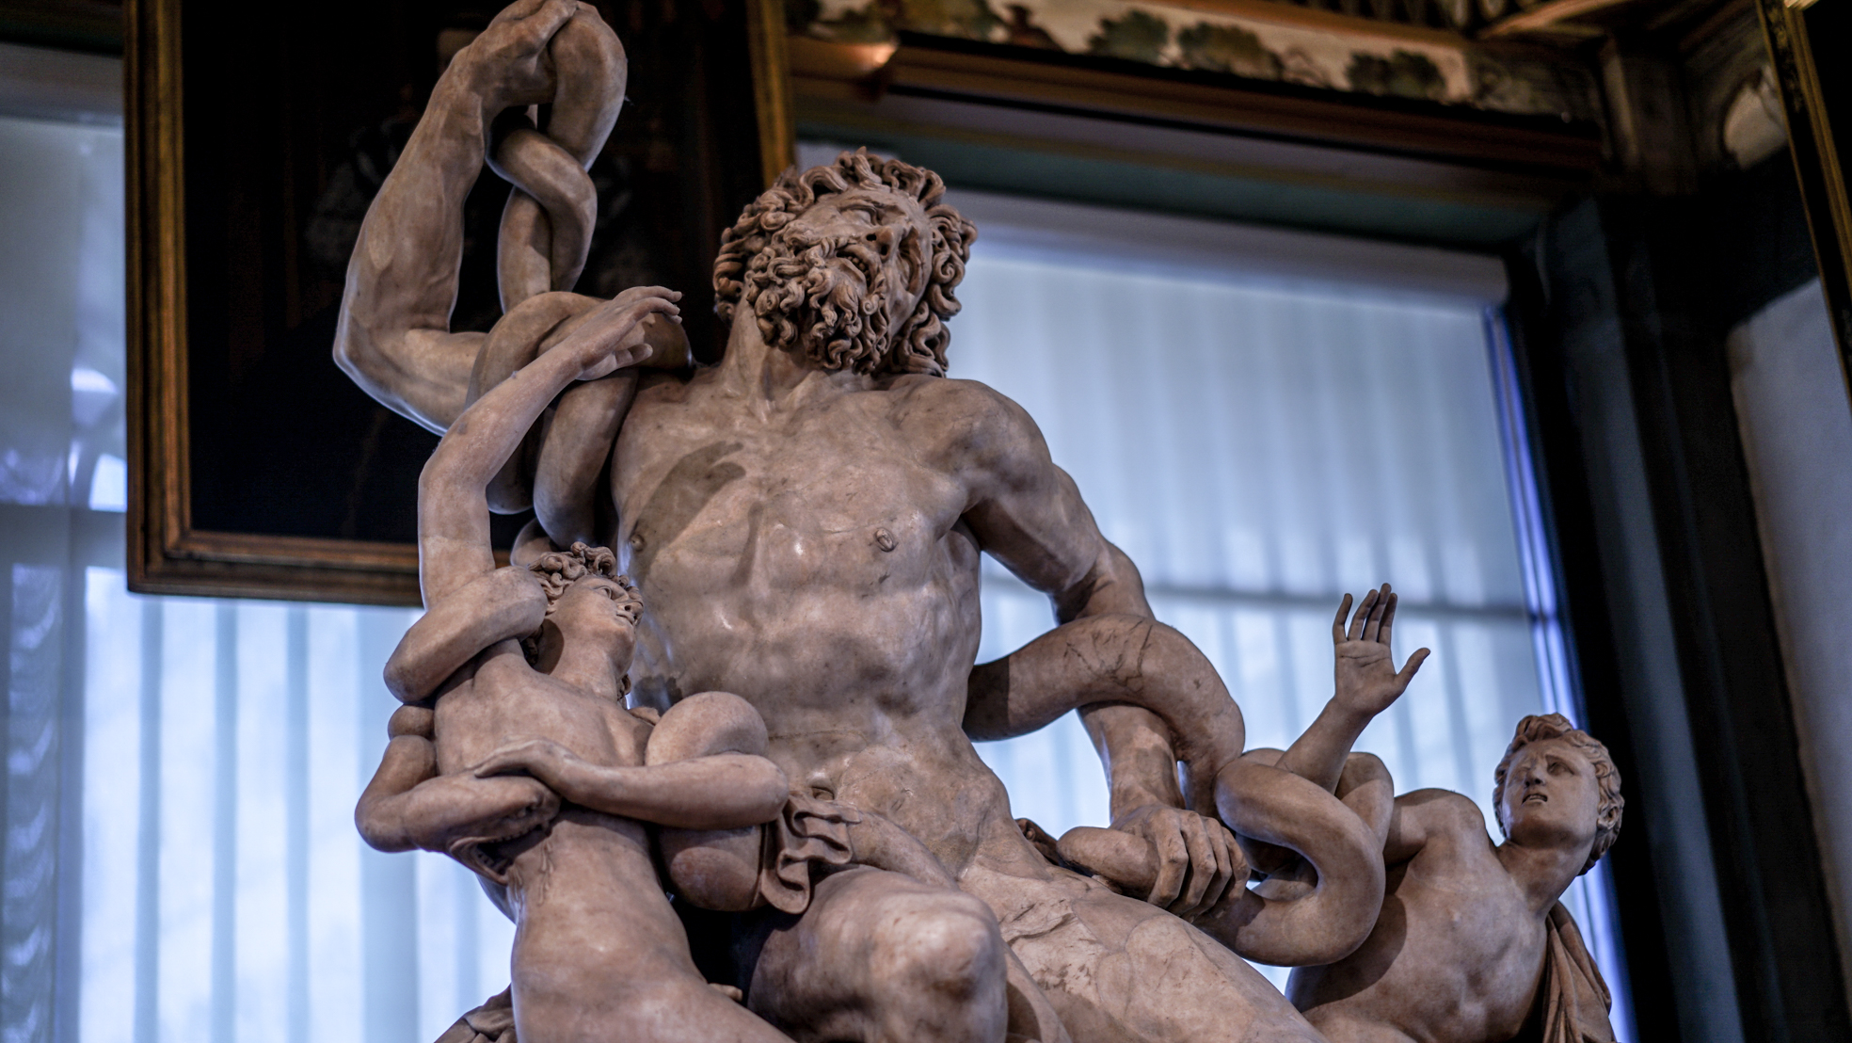
Firenze
The city attracts millions of tourists each year, and the Historic Centre of Florence was declared a World Heritage Site by UNESCO in 1982.

Slide 23
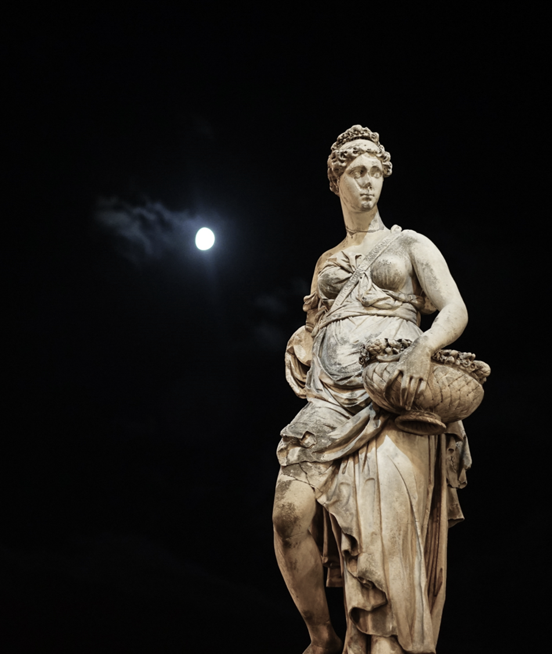
Firenze
The city attracts millions of tourists each year, and the Historic Centre of Florence was declared a World Heritage Site by UNESCO in 1982. The city is noted for its culture, Renaissance art and architecture and monuments.
The city also contains numerous museums and art galleries, such as the Uffizi Gallery and the Palazzo Pitti, and still exerts an influence in the fields of art, culture and politics.

Slide 24
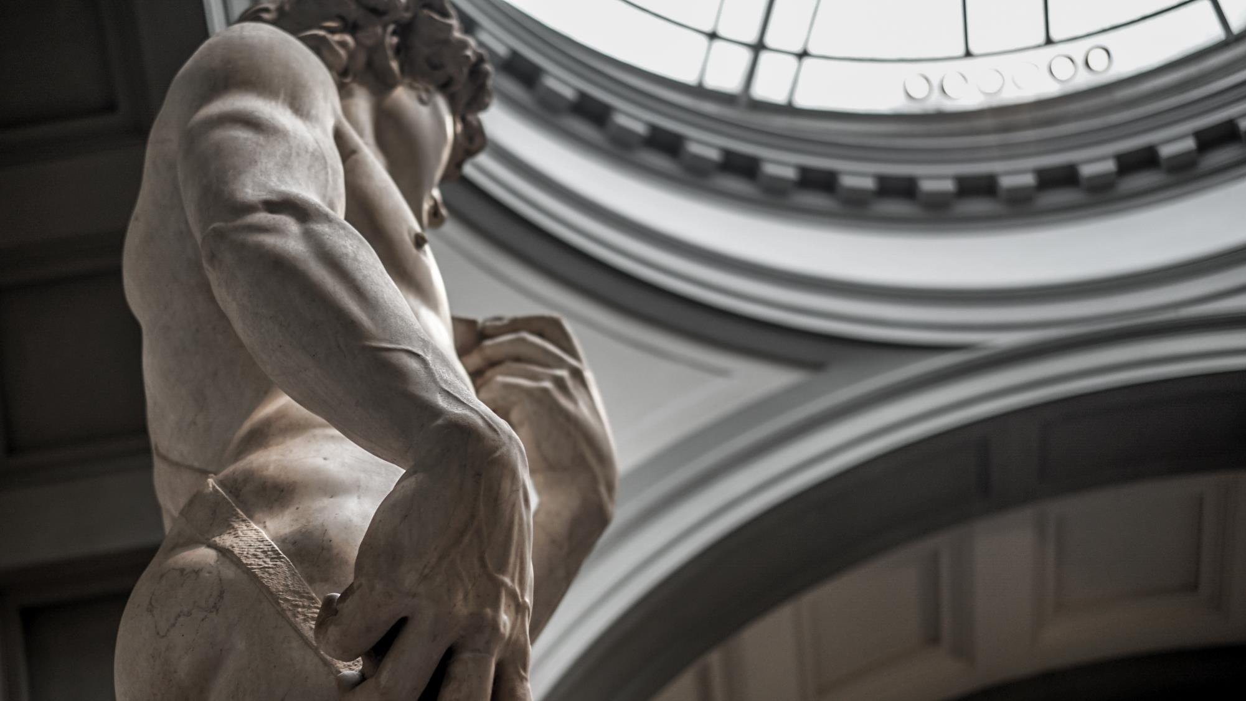
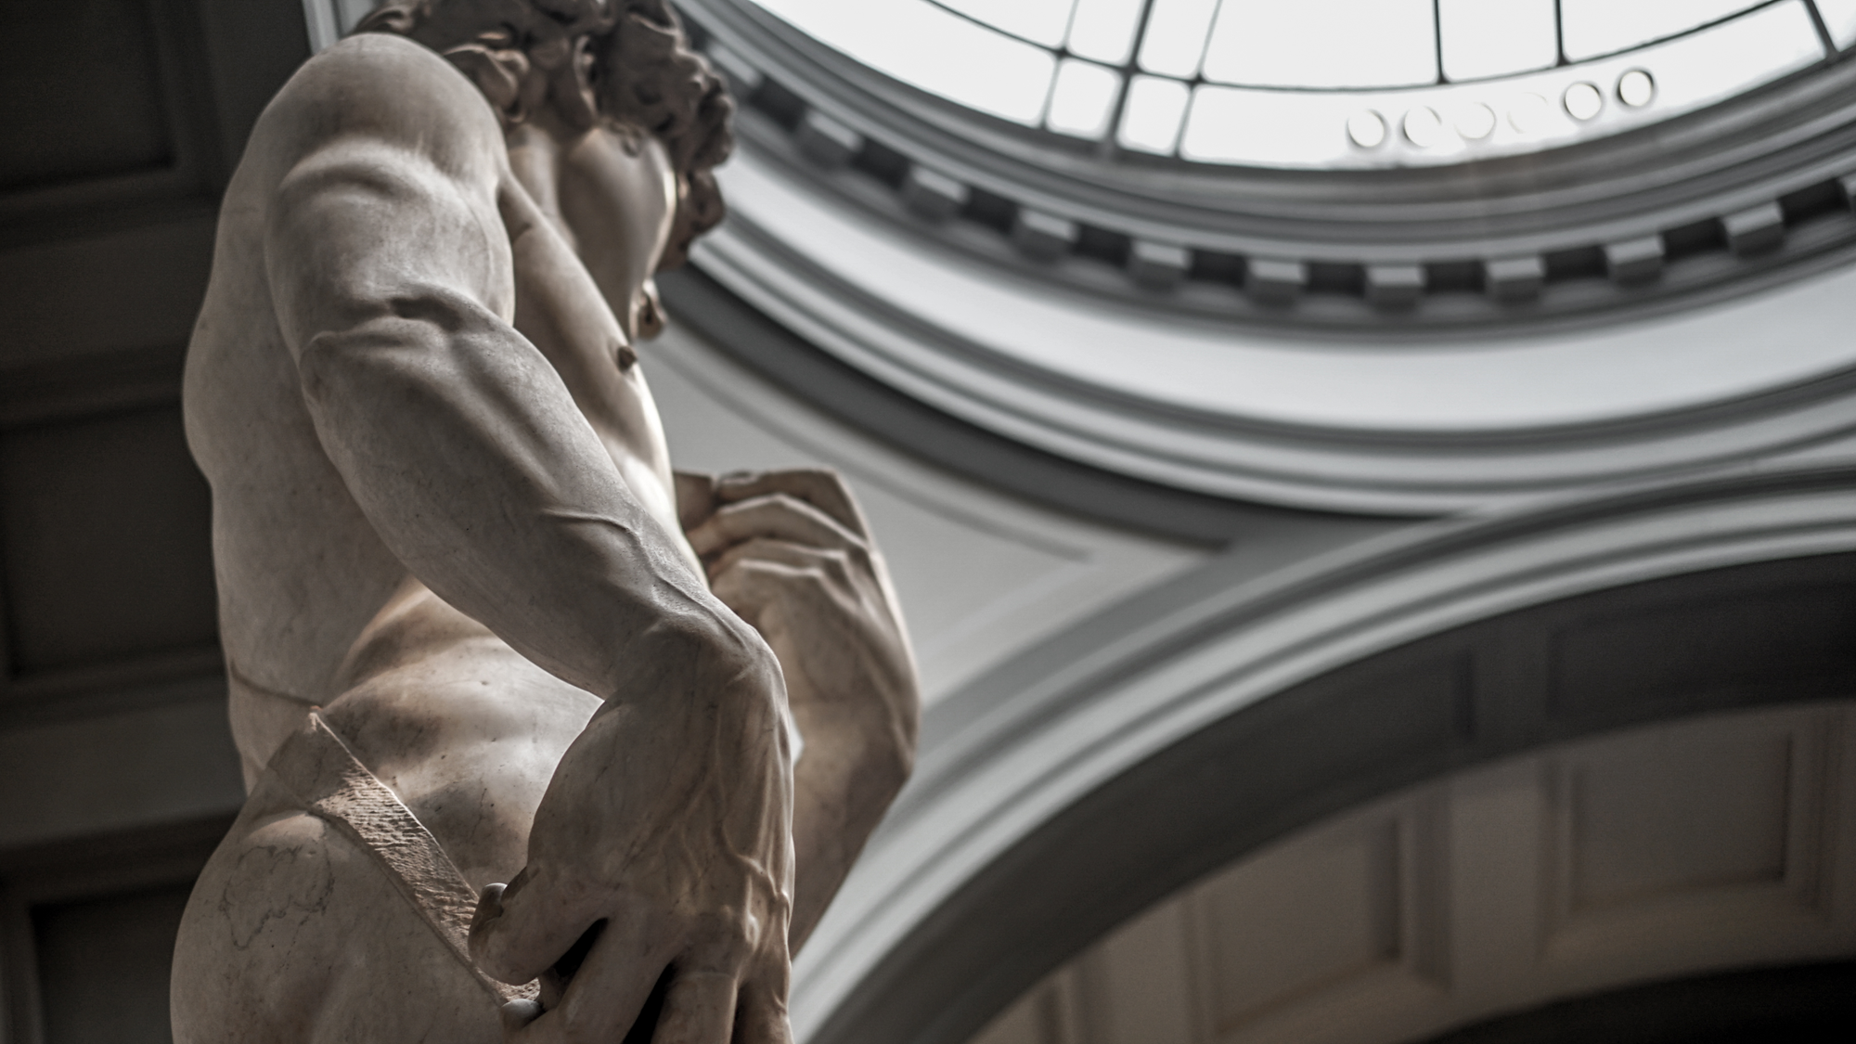
HOPE YOU
LOVE IT
Florence is the capital city of the Italian region of Tuscany and of the Metropolitan City of Florence. It is the most populous city in Tuscany, with 383,083 inhabitants (as at 2013), expanding to over 1,520,000 in the metropolitan area.

Slide 25
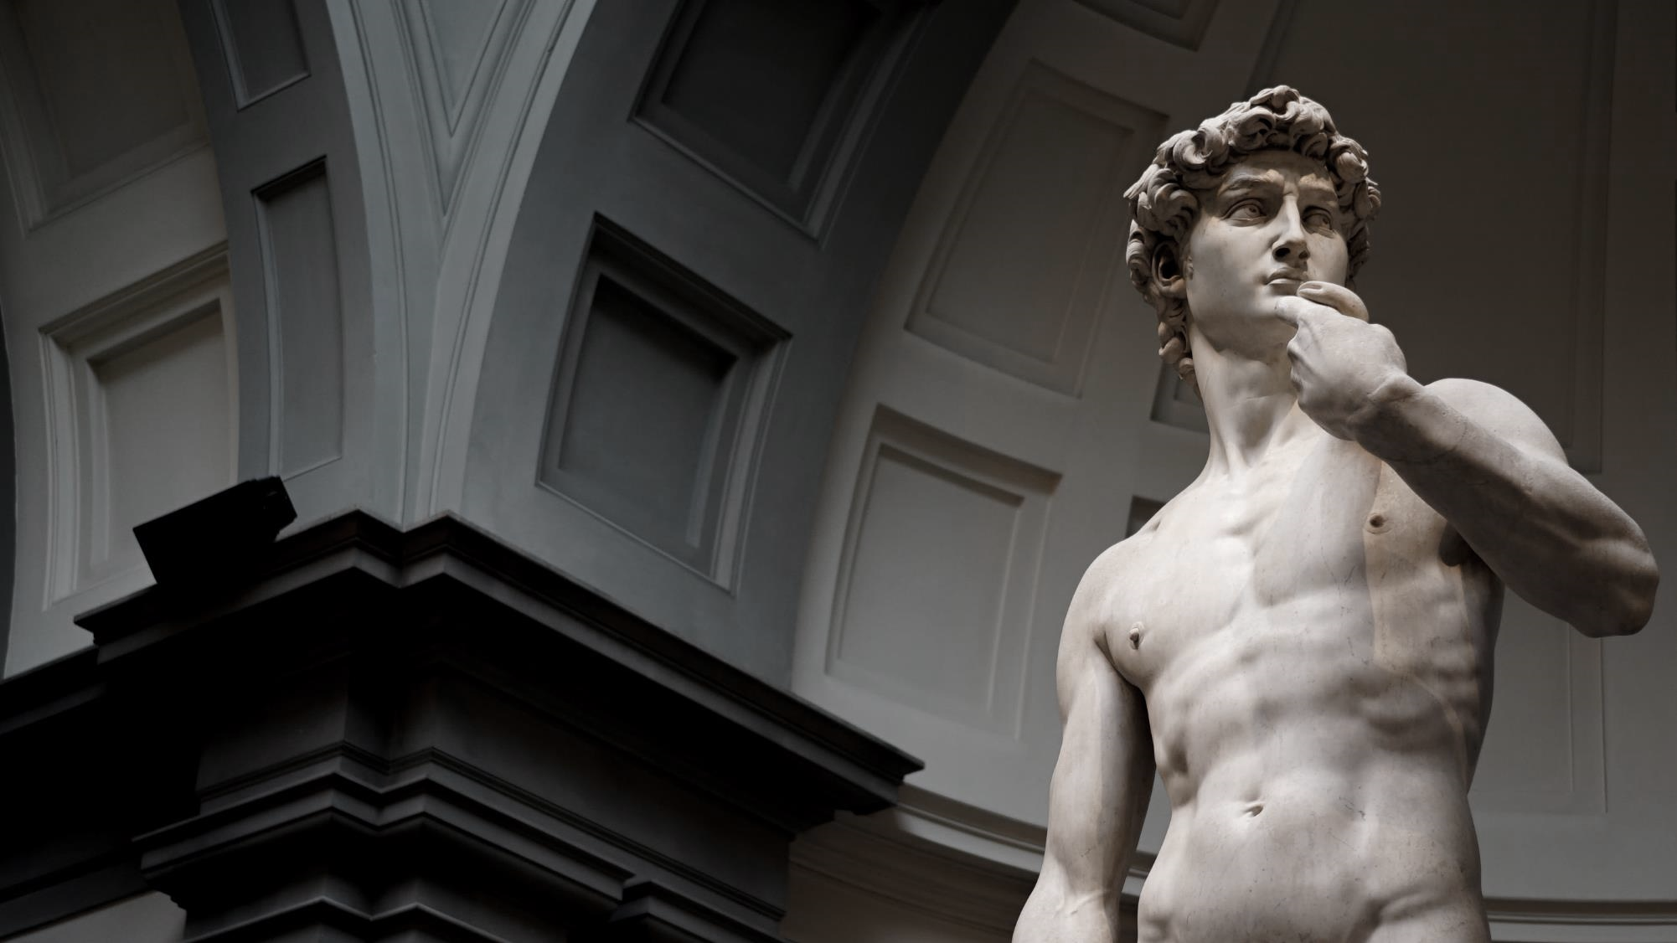
Michelangelo's David
It is a 5.17-metre (17.0 ft)[a] marble statue of a standing male nude. The statue represents the Biblical hero David, a favoured subject in the art of Florence.
Originally commissioned as one of a series of statues of prophets to be positioned along the roofline of the east end of Florence Cathedral, the statue was placed instead in a public square, outside the Palazzo Vecchio, the seat of civic government in Florence, in the Piazza della Signoria where it was unveiled on September 8th, 1504.
SIMON PPT

Slide 26
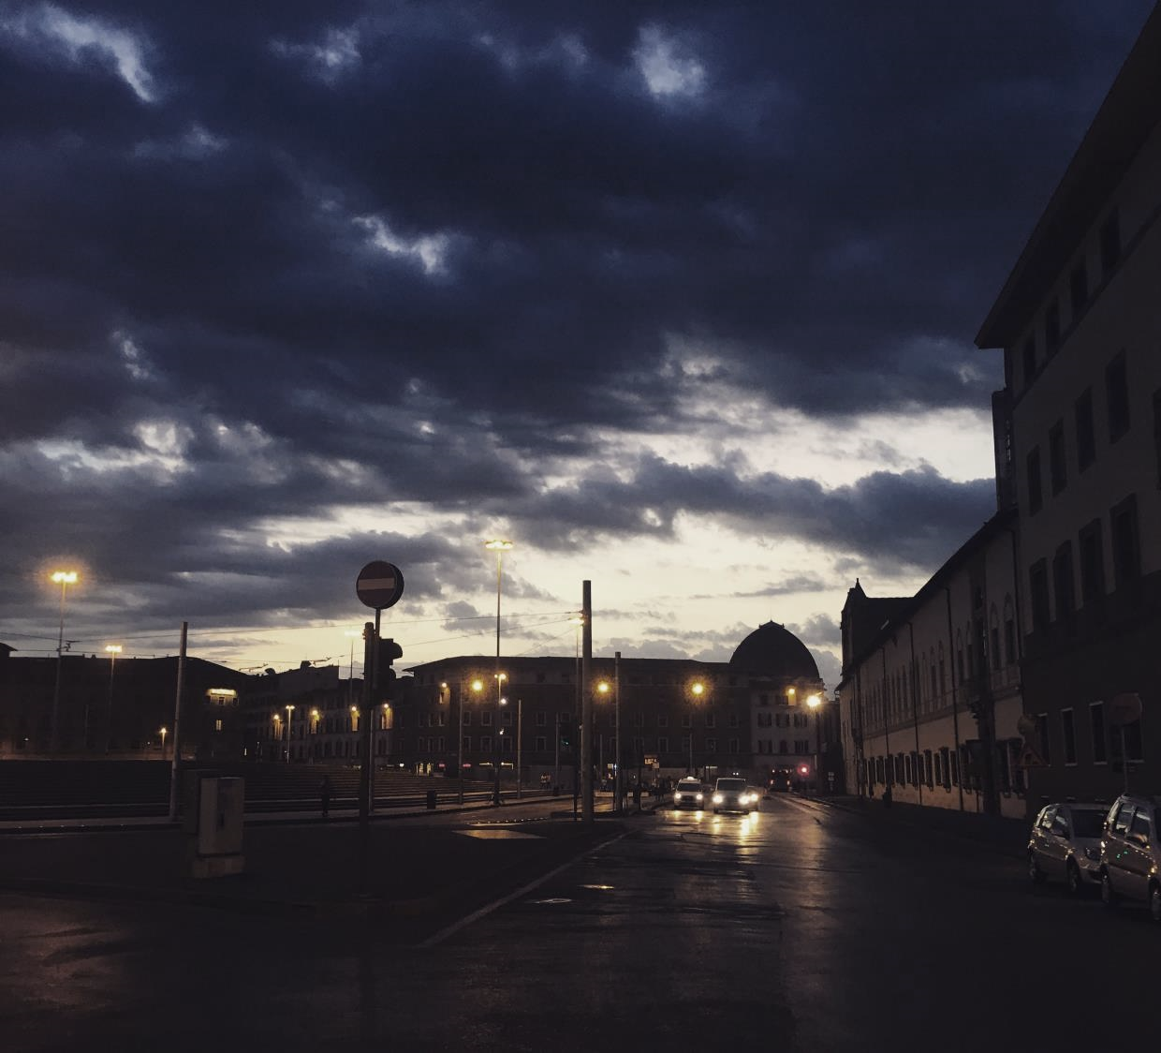
A
BREAK
SLIDE
FROM
FIRENZE
SIMON PPT
MORE THAN PPT

Slide 27
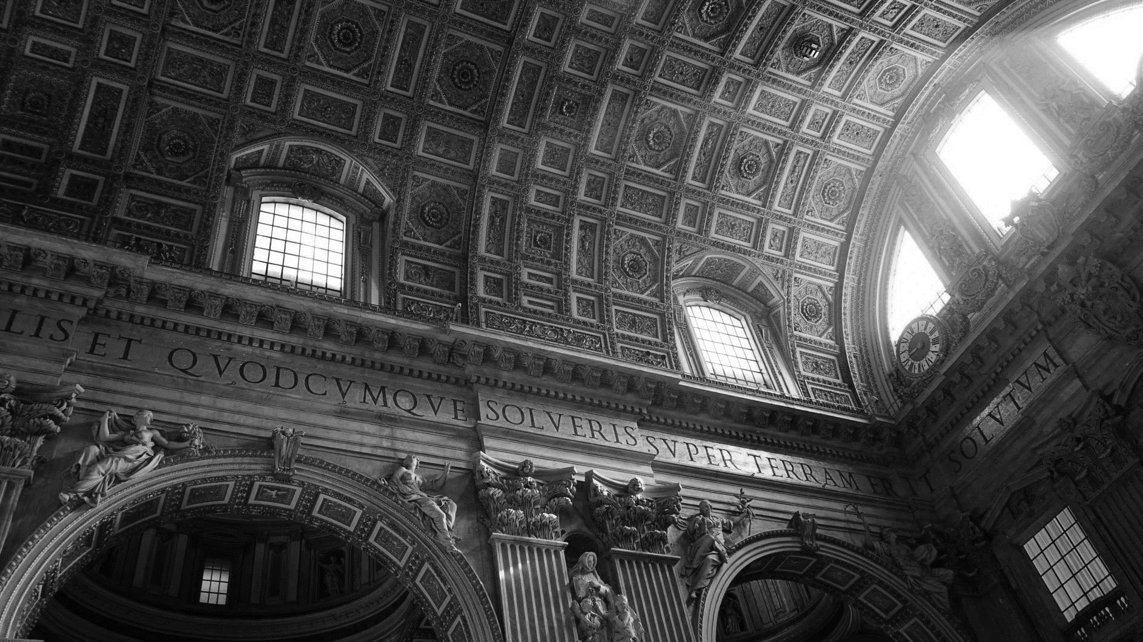
I BROUGHT YOU A
POWER POINT TEMPLATE
FROM ITALY.
SIMON PPT
MORE THAN PPT

Slide 29


Slide 30


Slide 31


